Slide 1
Data Structures & Algorithms (CSC-214)
Lec 2: OOP recap

Slide 2
Example – Library Management (1)
The library holds multiple books, and each book has details like its title, author, price, and a unique ID.
When a new book is added to the library, you can enter details manually or use default values if some information is missing.
A book can be removed from the library records
Instead of assigning a fixed number of shelves for books, the library can adjust its storage based on the number of books present.
Some information, like a book’s unique ID, should only be modified by the library and not by visitors. However, details like the title and author can be publicly viewed.

Slide 3
Example – Library Management (1)
You should be able to combine two books into a special bundle, compare two books to check if they are the same, and have the functionality to print the book’s details in a formatted manner.
Some rules should never change—eg, a book’s title shouldn’t be modified once it’s registered.
You should be able to create an exact duplicate of an existing book

Slide 4
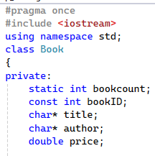
Attributes

Slide 5
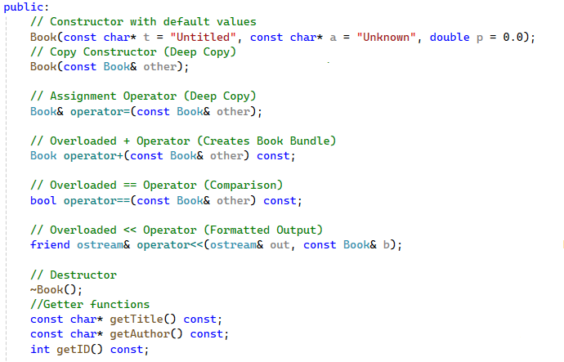
Member functions

Slide 6
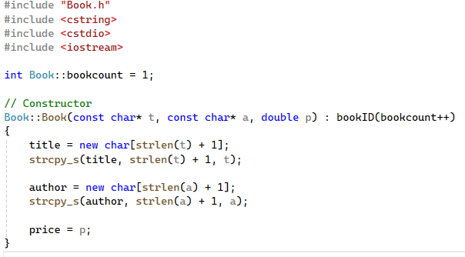
Implementation File (1)

Slide 7
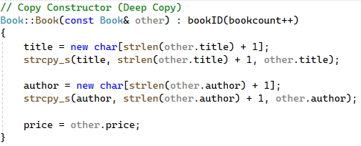
Implementation File (2)

Slide 8
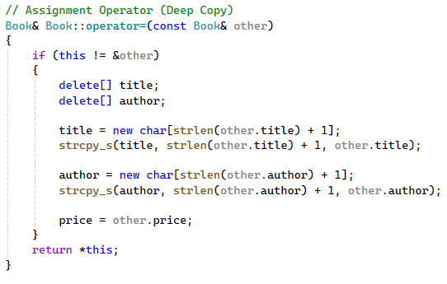
Implementation File (3)

Slide 9
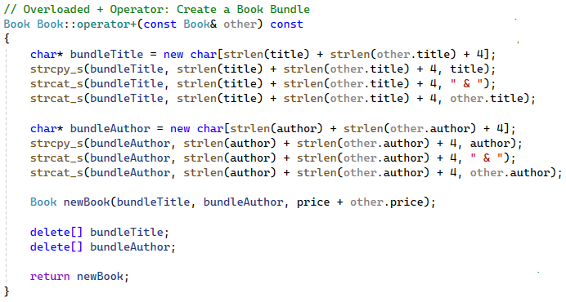
Implementation File (4)

Slide 10
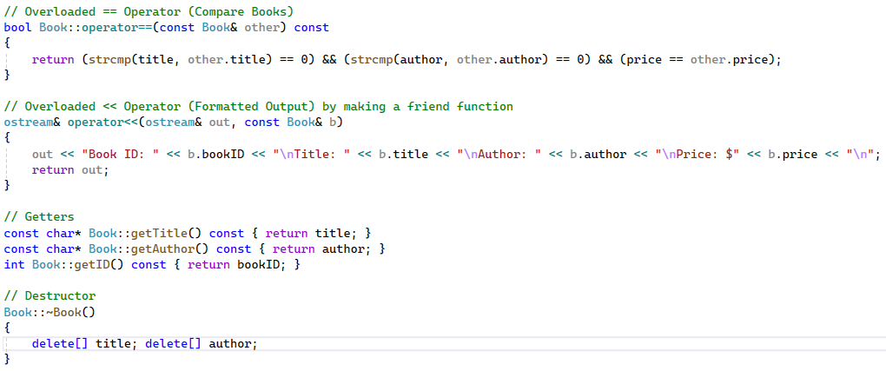
Implementation File (5)

Slide 11
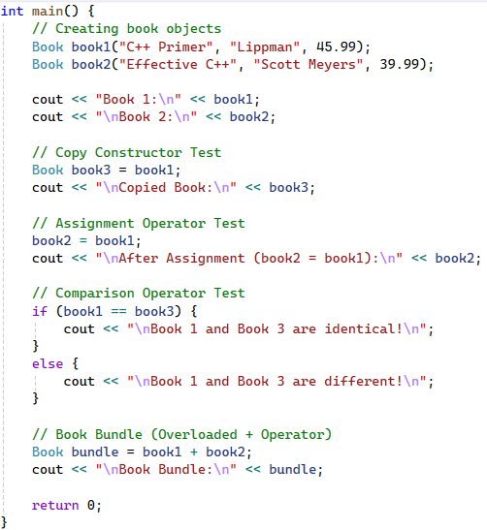
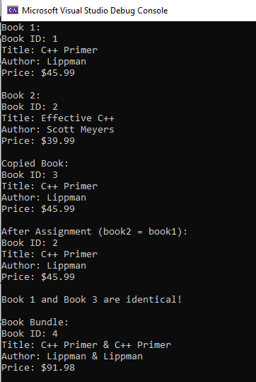
main.cpp

Slide 12
String class

Slide 13
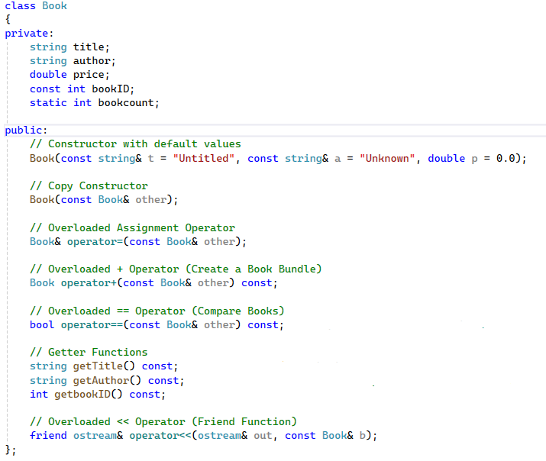
Header File

Slide 14
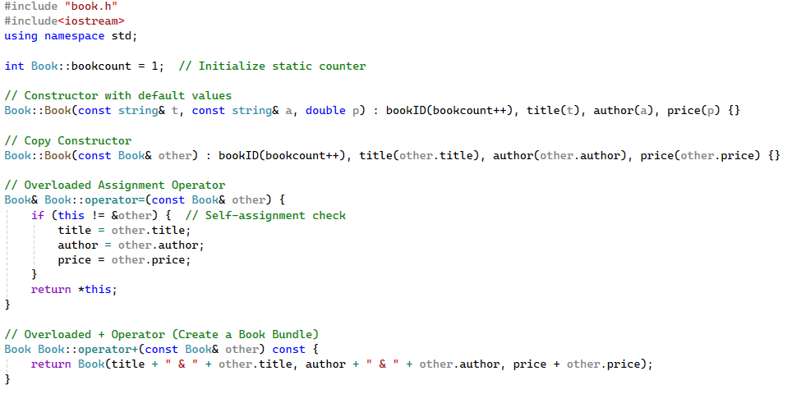
Implementation File (1)

Slide 15
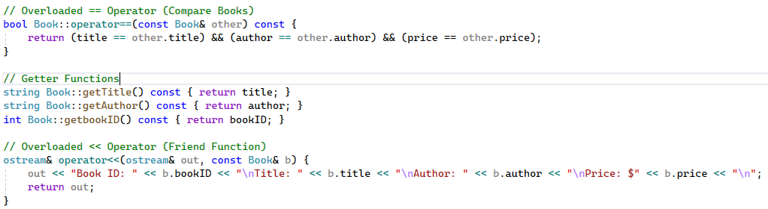
Implementation File (2)

Slide 16
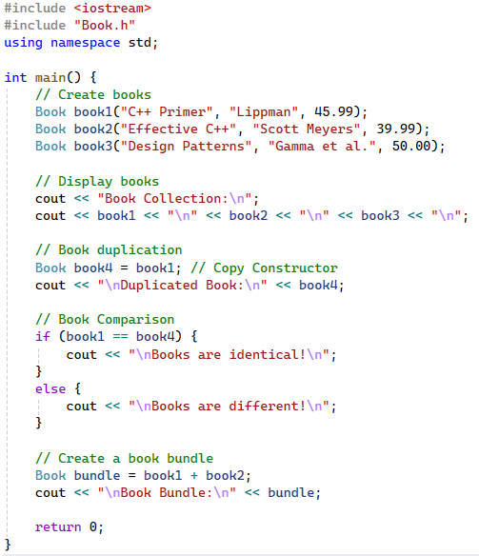
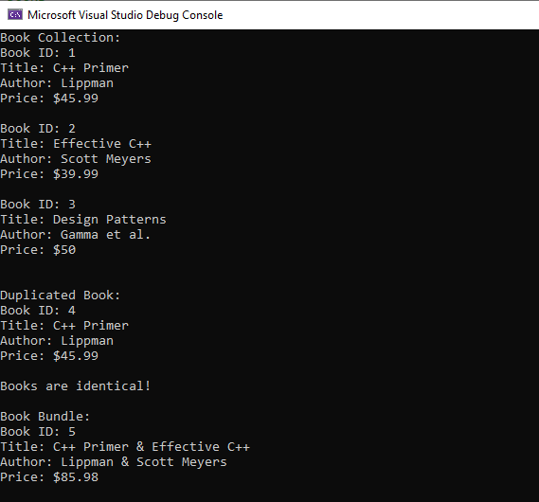
main.cpp file

